Slide 1
Course Title - DevOps
Topic Title - DevOps Tools and Technologies
Continuous integration with Jenkins 2
Presenter’s Name - M ArunKumar
Presenter’s ID - IARE11151
Department Name - CSE (AI & ML)
Lecture Number - #
Presentation Date - ##/03/2025

Slide 2
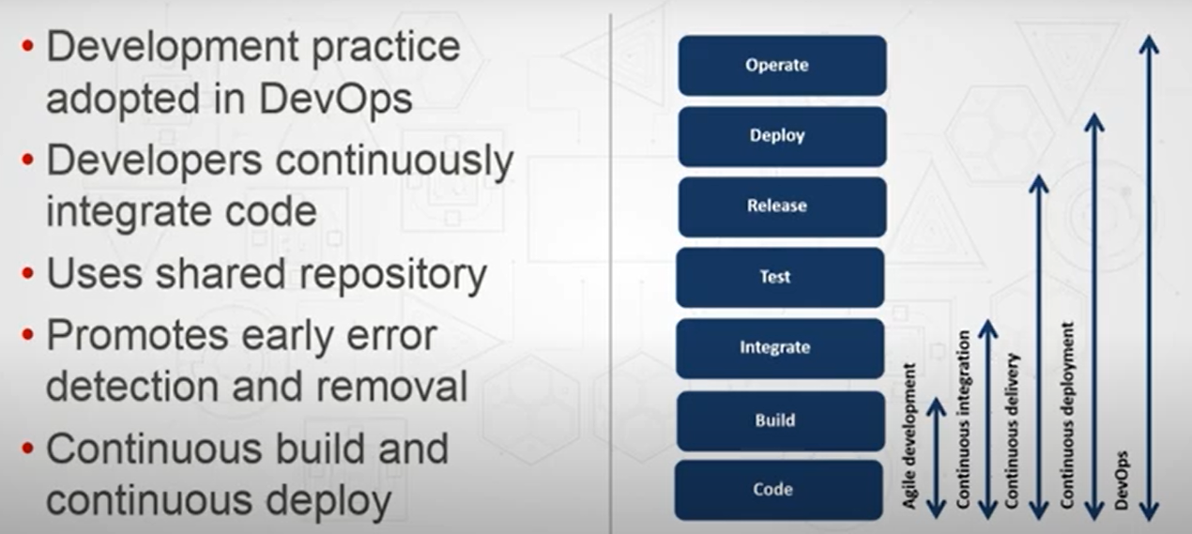
Continuous integration with Jenkins 2

Slide 3
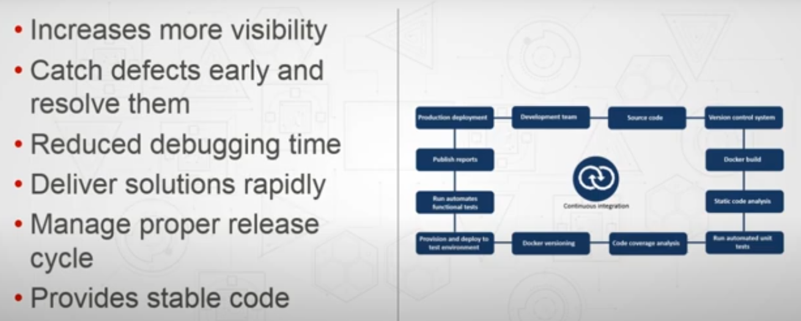
Continuous integration - Benefits

Slide 4
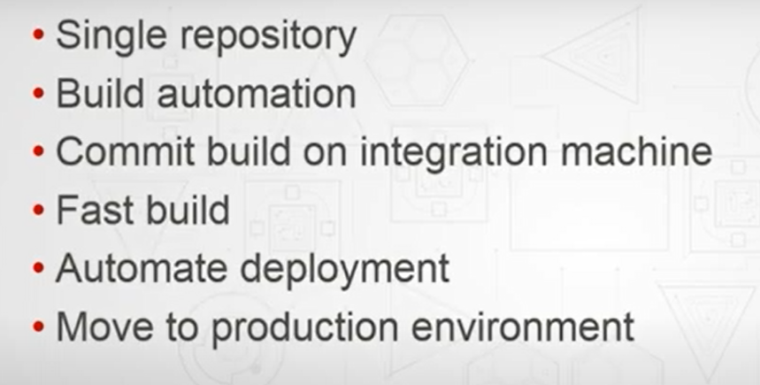
Continuous integration - Principles

Slide 5
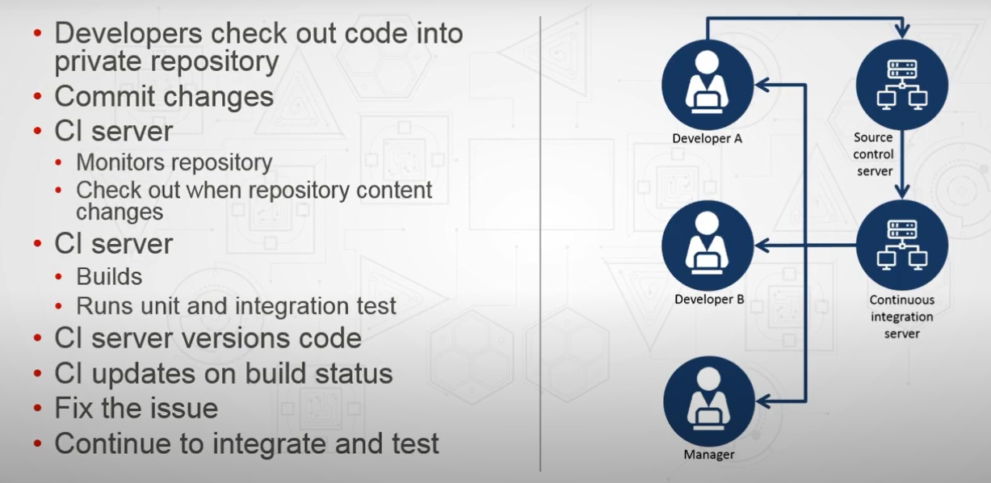
Continuous integration - Activities

Slide 6
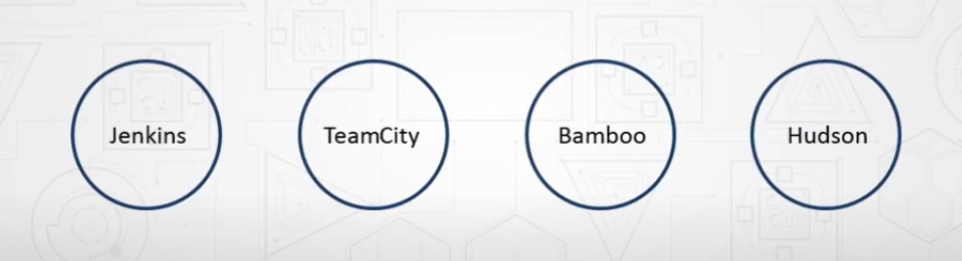
Continuous integration - Tools

Slide 7
Thank You

